Slide 1
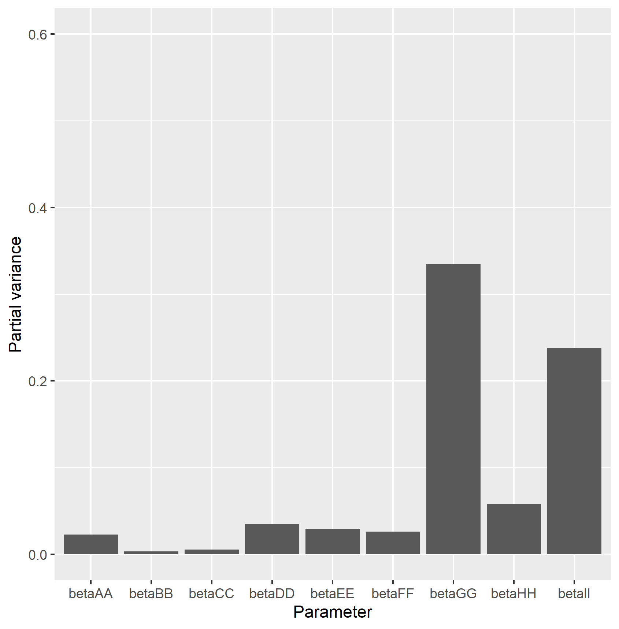
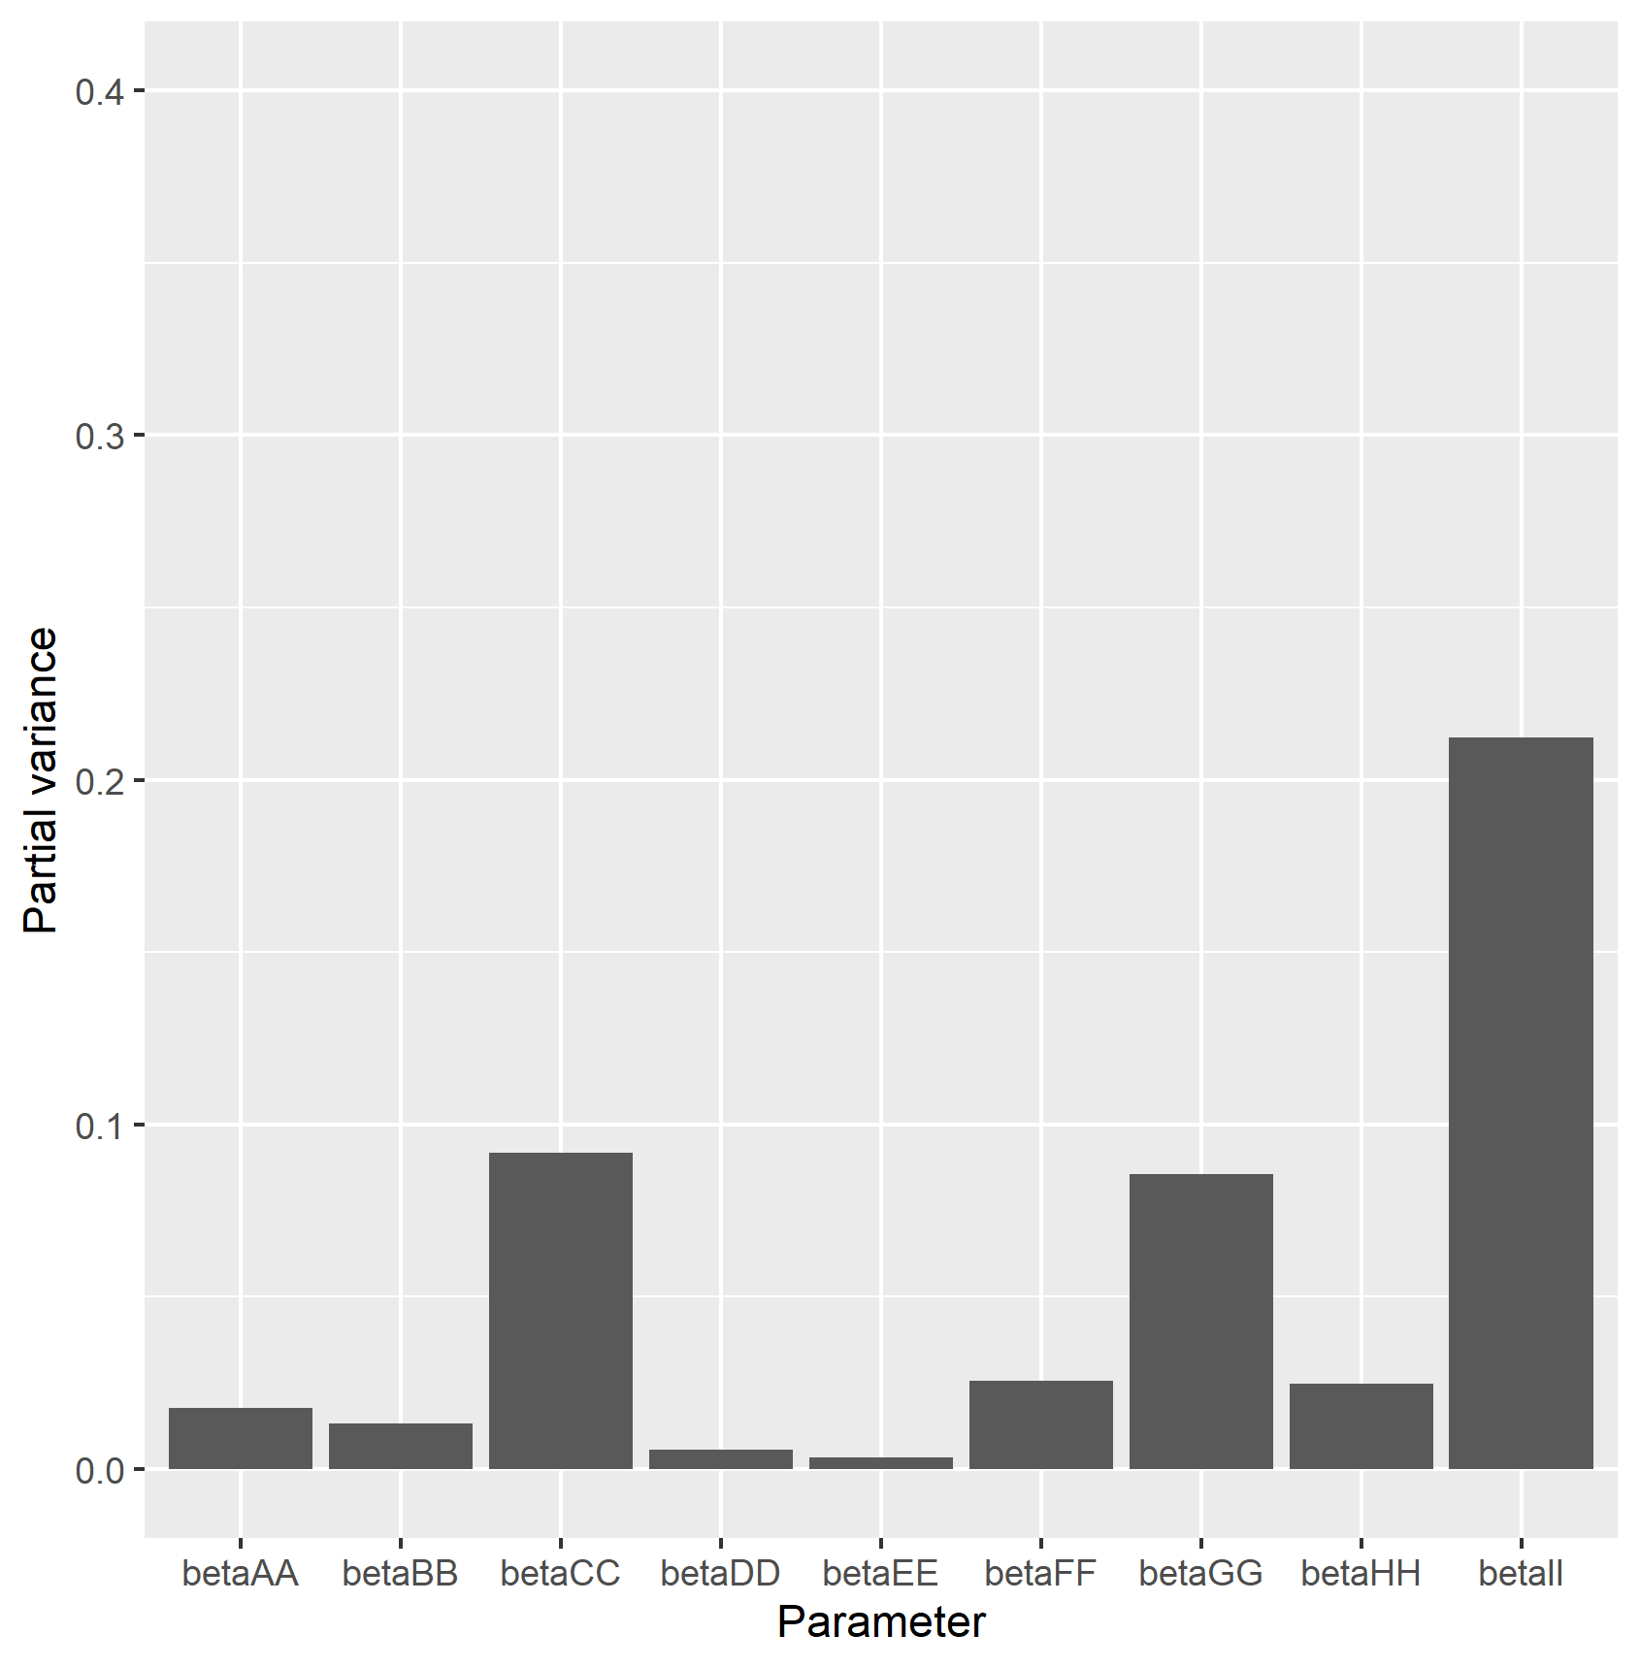
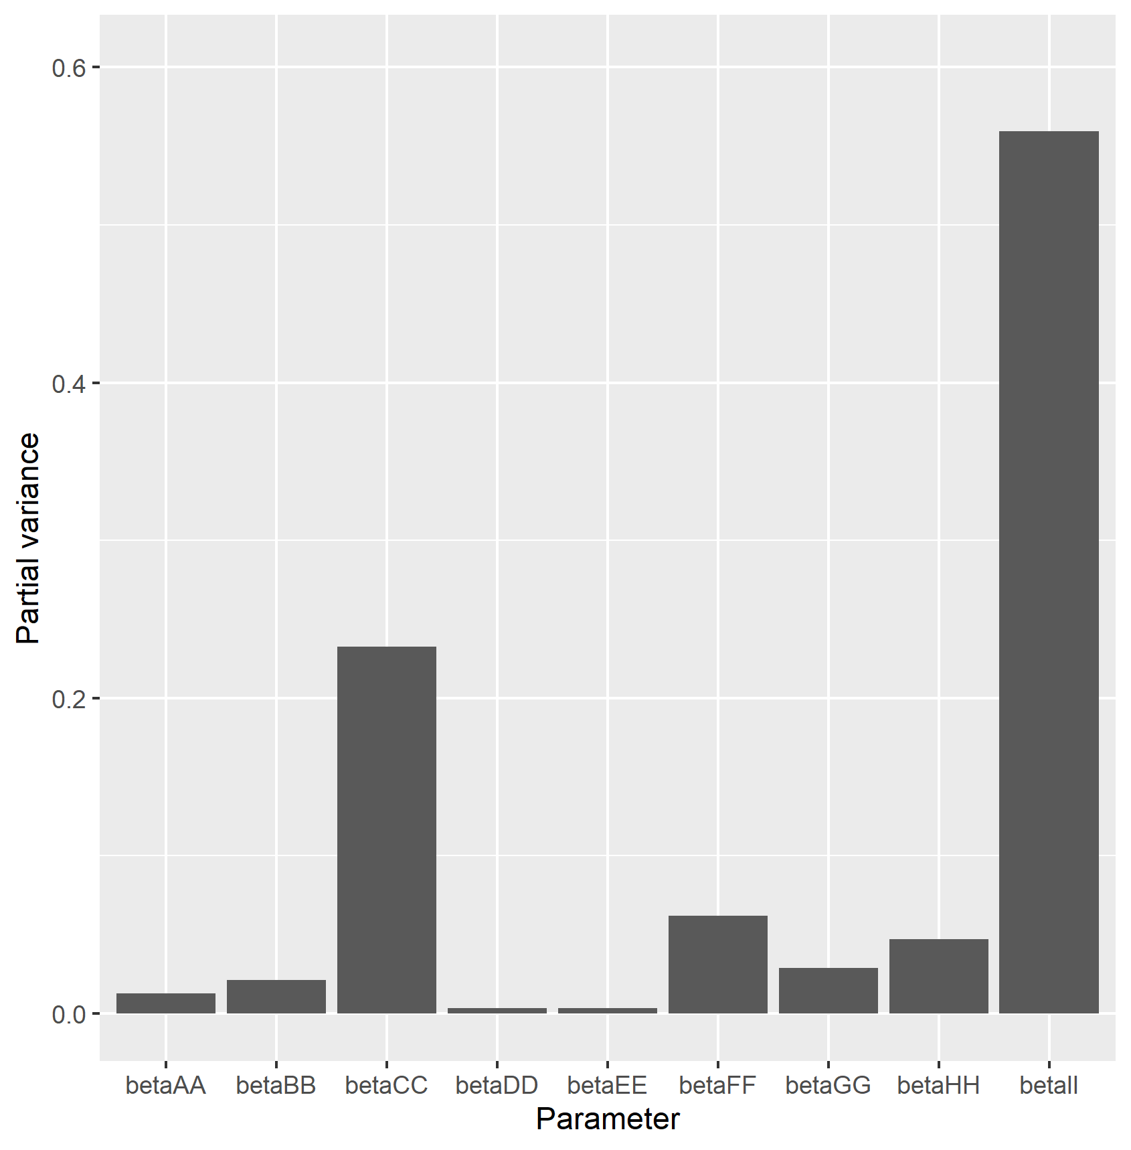
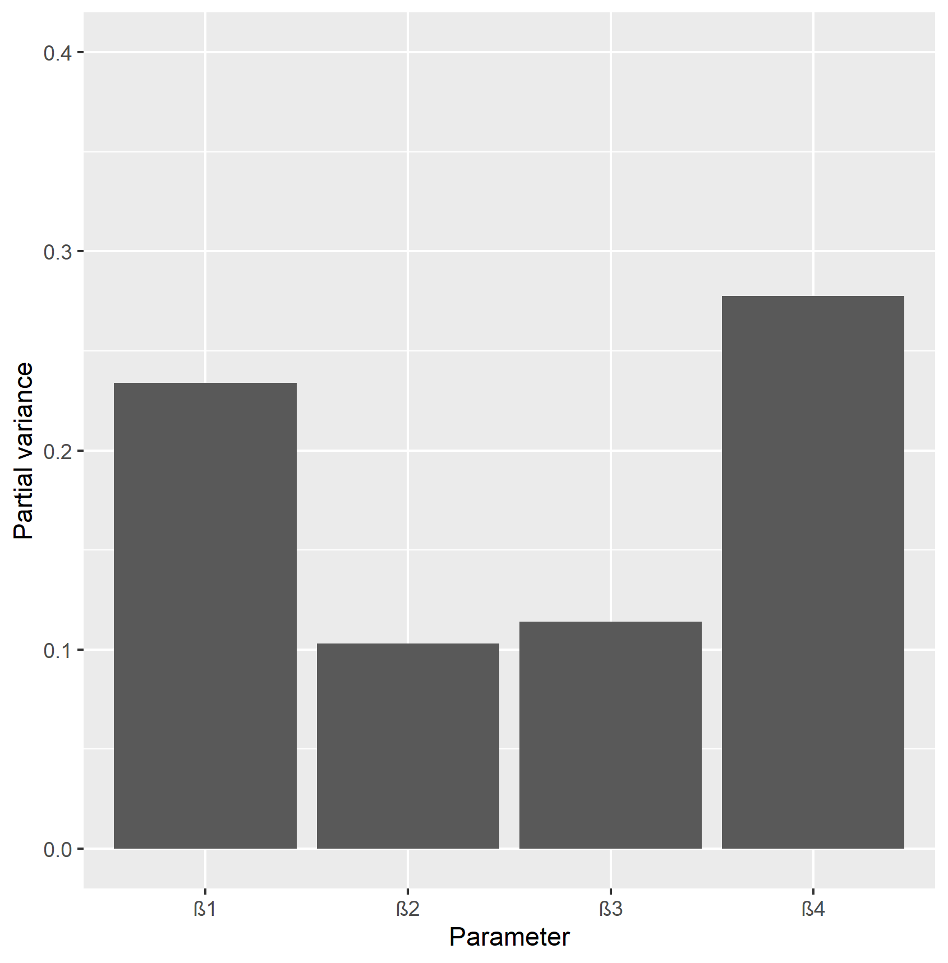
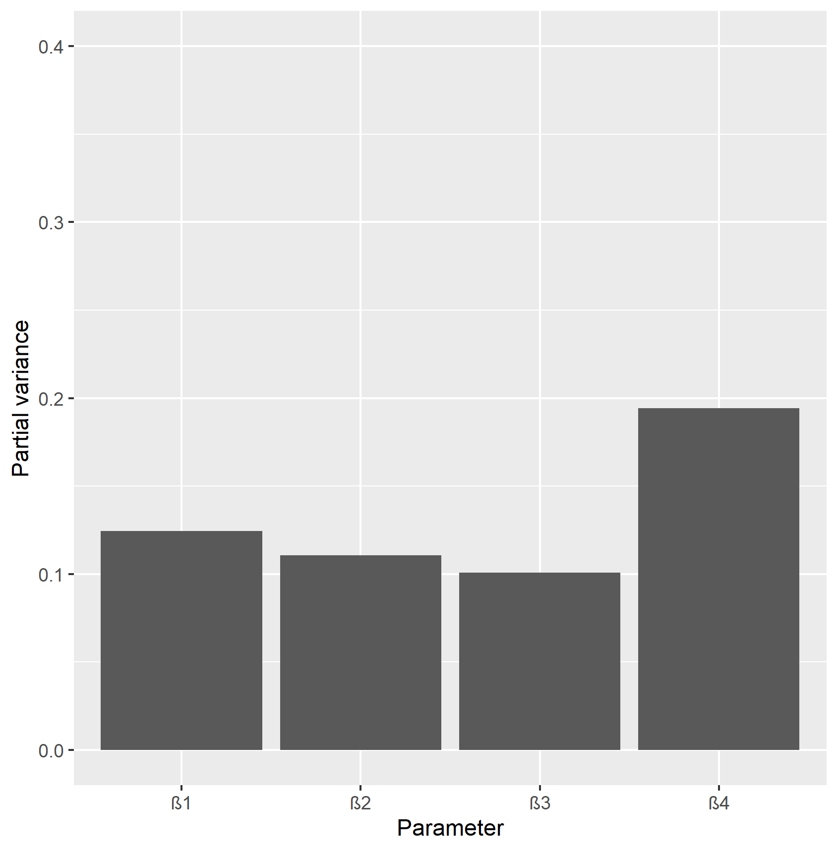
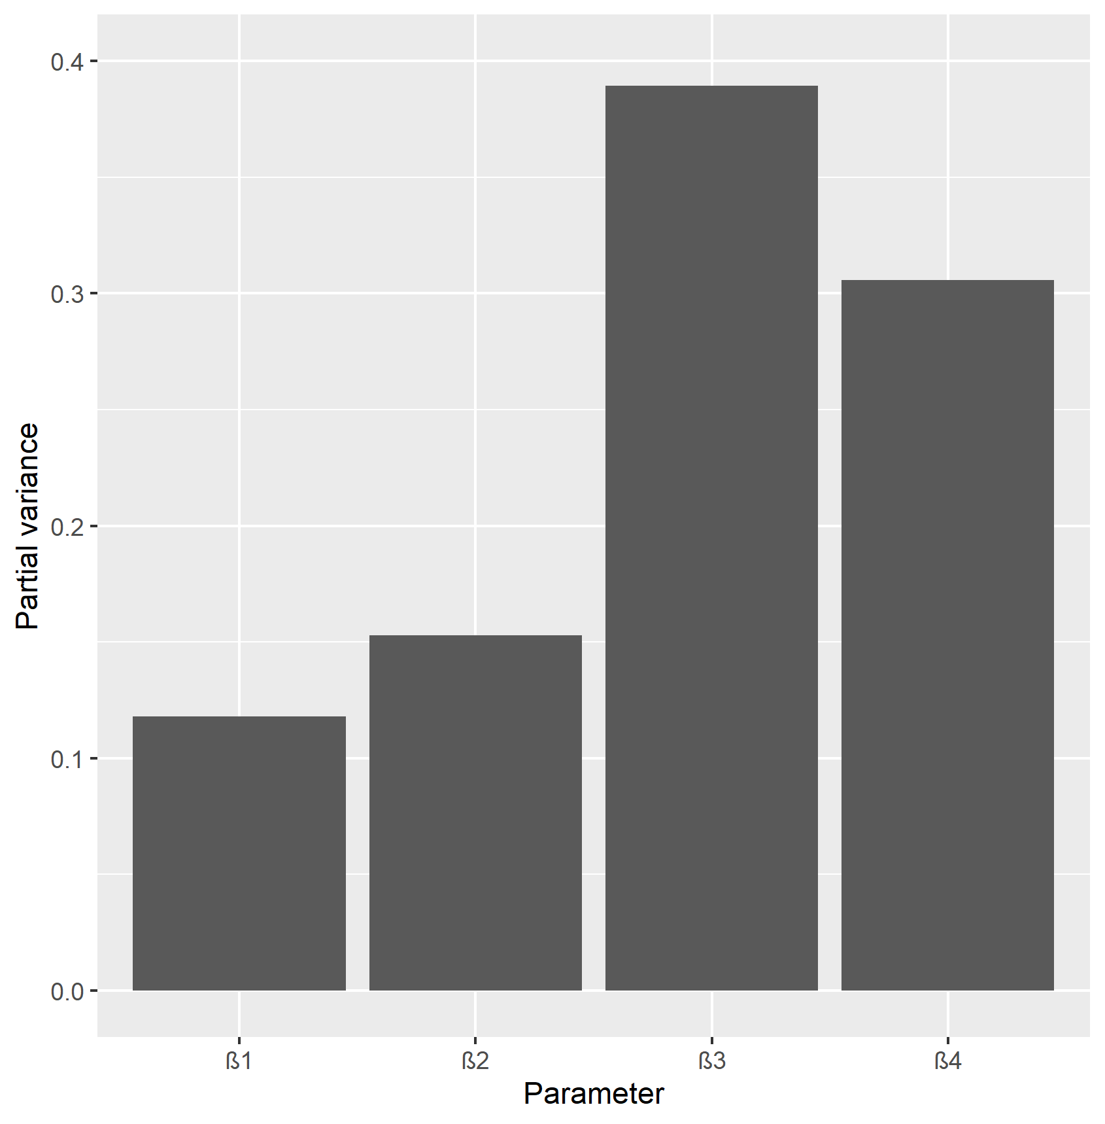
A
To/From |  | Vulnerable | Shielders | Remainders
 |  |  |  | Remainders 1 | Remainders 2 | Remainders 3
Vulnerable |  | AA | BB | CC | CC | CC
Shielders |  | DD | EE | FF | FF | FF
Remainders | Remainders 1 | GG | HH | II | II | II
 | Remainders 2 | GG | HH | II | II | II
 | Remainders 3 | GG | HH | II | II | II
Is the Second I_{V} Peak Higher than the first?
Cumulative Infections in Vulnerables after 1 yr
B
Height of Second Peak
C
Is the Second I_{V} Peak Higher than the first?
Cumulative Infections in Vulnerables after 1 yr
Height of Second Peak

Slide 2
Height of second peak
Second peak higher?
Cumulative_Iv_1y

Slide 3
A
To/From |  | Vulnerable | Shielders | Remainders
 |  |  |  | Remainders 1 | Remainders 2 | Remainders 3
Vulnerable |  | AA | BB | CC | CC | CC
Shielders |  | DD | EE | FF | FF | FF
Remainders | Remainders 1 | GG | HH | II | II | II
 | Remainders 2 | GG | HH | II | II | II
 | Remainders 3 | GG | HH | II | II | II
B
C

Slide 4
